Slide 1
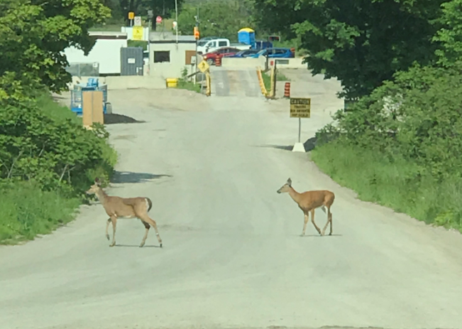
Teedon Pit
June 18, 2019

Slide 2
Update
Teedon Pit
Minor site plan amendment approved.
Teedon Pit
PTTW
The Ministry has not made a decision on permit renewal.
Teedon Pit Extension
Upcoming pre-hearing conference call for participants/appellants scheduled July 2, 2019.

Slide 3
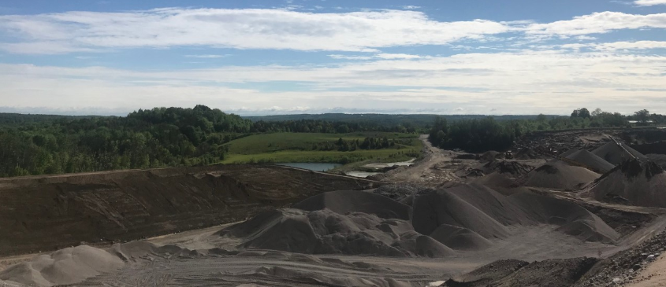
Operational Update
Prepare new area to be extracted
Continue to extract, process and wash

Slide 4
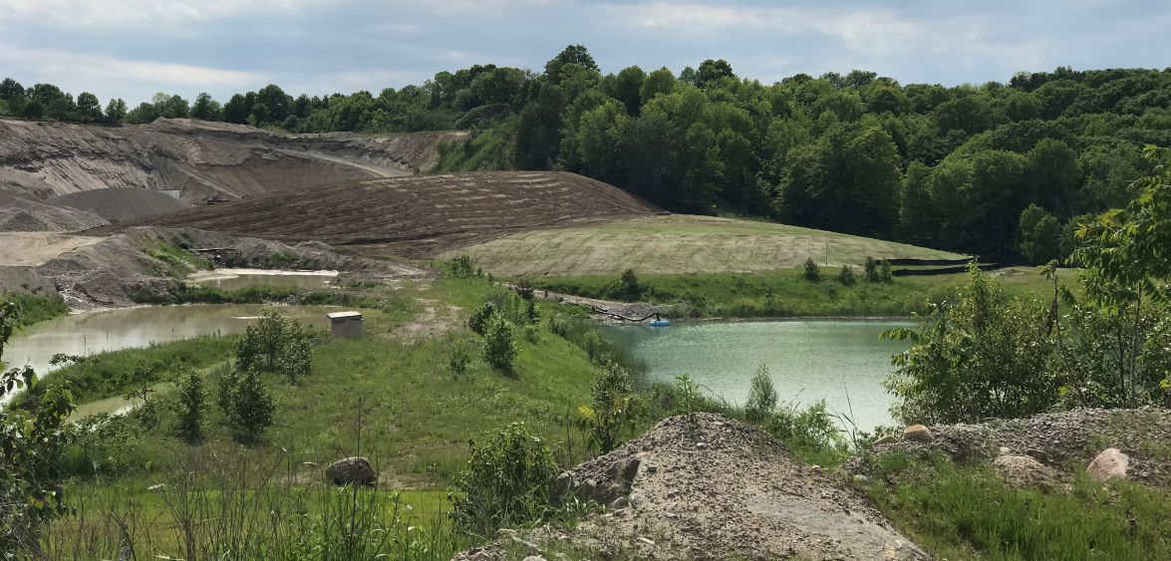
Operational Update
Continue to ship product to customers
Construction of new noise berm

Slide 5
Minor Site Plan Amendment approved May 28, 2019
Highlights of the minor amendment:
Added labels to surrounding roads (Marshall Road, McMann Road, Highway 93 and Darby Road);
New Note: The genset trailers for both the wash plant and the processing plant shall be oriented with the exhaust discharge pointed away from due east);
New Note: Inclusion of onsite communication tower that will be removed as part of final rehabilitation.
New Note: An internal turn-around road north of the portable trailer, scale house, scales and communications tower area to accommodate a more safer traffic flow.
Housekeeping: A few examples would be replacing the word “power plant” with “generator”; renaming the “overflow ditch” located north of the sump pond to “emergency overflow ditch”;

Slide 6
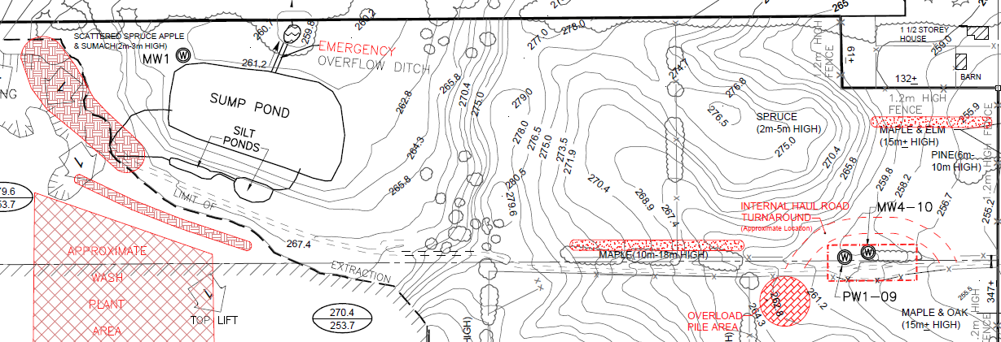
Minor Site Plan Amendment approved May 28, 2019
Additional Noise Berms:
Added an additional note to permit a 7 metre offset for the licence boundary fencing along Darby Road for landscaping purposes. The optional berm will be 3-5m high with a minimum of 2:1 slope;
Added an additional note to permit an optional berm adjacent to 30 Darby Road in the northeast corner of the site. The optional berm will be 3-5m high with a minimum of 2:1 slopes;
Construct two overlapping noise mitigation berms in the setback along the silt ponds and the sump pond. The berms will be 4-6m high with a minimum of 2:1 Slopes. The berms will provide noise mitigation measures to the residential properties to the northeast. As a result of adding the berms, the wash plant area will be shifted south to be shielded by the berms

Slide 7
CLC Tracking Sheet – Update
Refer to Excel

Slide 8
Next CLC Meeting
Potential Tour in the Fall 2019

